Slide 1


Slide 2



Wine, Chocolate, Movie
February 14th, 2020

Slide 3

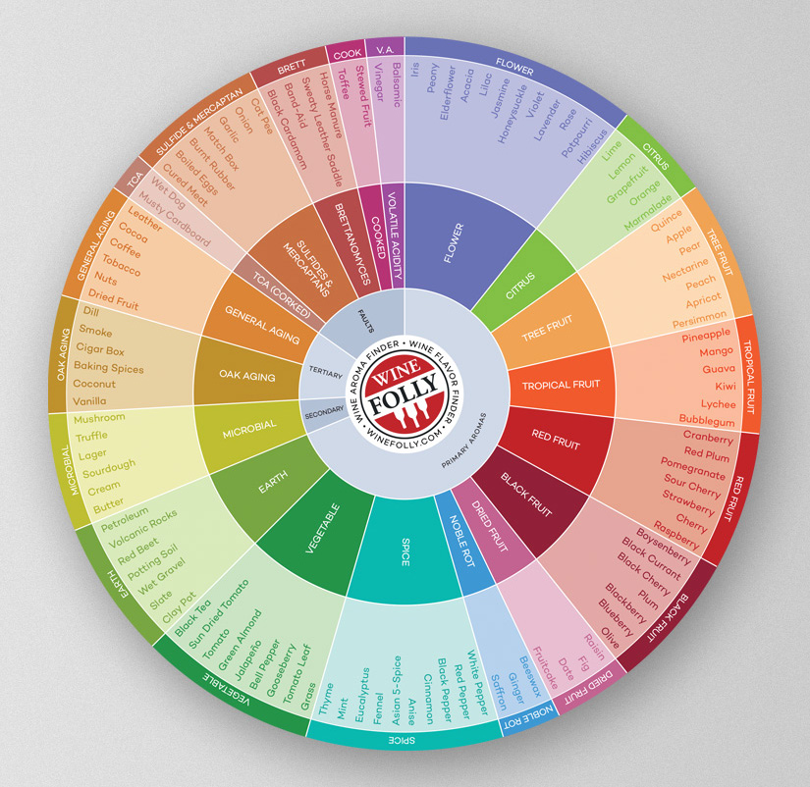
Tasting
See
Swirl
Smell
Sip
Notes:
See
Notice the color and intensity
Is the wine clear or hazy?
Swirl
Gently swirl the wine around in the glass to release aromas
Smell
What aromas do you smell?
Are they light or intense?
Sip
What flavors do you taste?
Does the wine feel light or heavy?
What sort of textures do you feel?
How much does it make your mouth water?
How long to the flavors linger?
Aroma Wheel
Primary v. Secondary v. Tertiary

Slide 4

Notes:
Should be entertaining for both
Should be heartwarming at least to stoke the romantic flames
Should be uplifting (not schindler’s list) crucial to lock in your movie vibe
Is it February that just brings out the crazy need to feel somewhat romantic with your spouse? Maybe, it’s just the time of year?
Christmas was two months ago, and we all spent way too much and regretted it. All through January most of us hibernated because it was just too dark outside to get out after work.
But here is February. Ok, depths of what should be winter, and we realize that actually spending time with people again is a good thing.
So, there it is, Hallmark gives us Valentine’s Day. Marketing leading up the to this day tells us we should be looking forward, with glorious hopes, to our loved one giving us some kind of sappy card and delicious chocolate that comes in a heart shaped box. If that doesn’t’ get him out of the doghouse for you ladies, he might also bring home a bottle of wine, flowers and a chick flick. How did we get here?

Slide 5
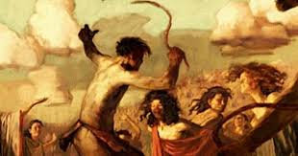
Festival of Lupercalia –somewhere in the 6th Century
Notes:
The origins of Valentine’s Day are far from clear. Of course, the internet is 100% accurate in my short search on the subject.
It likely started as a pagan Roman fertility festival of Lupercalia Lu per cale e a (somewhere in 6th Century BC).
Where the gift giver (man) offers a lovey whipping to the receiver (woman) in hopes of fertility.
Men and women would be coupled up by chance for a year to see if anything came of it.
As any good pagan holiday would have it, the Christians would get involved and retool it.
Legendary 3rd century Saint Valentine was imprisoned for converting men and women to Christianity and secretly marrying these couples. Roman emperor Claudius II had Saint Valentine executed on February 14th. Later in 496 AD, Pope Gelasius commemorated the martyred saint.

Slide 6

Flowers made a statement.
Notes:
Floriography (Flor e og ra fy) is the language of flowers and cryptical communications through specific arrangements or in symbols.
Idea of floral symbolisms are threaded particularly though the Bible in the smutty book of The Song of Solomon. Flowers made a statement.
Go the easy route, sure, rose sends a love, romance, beauty, perfection message.
Or you can be more exacting with Peonies - romance, prosperity, bashfulness;
or show her you are willing to spend a little more and tell her you are significantly joyful, deeply old-fashioned in love by handing her a gardenia.

Slide 7
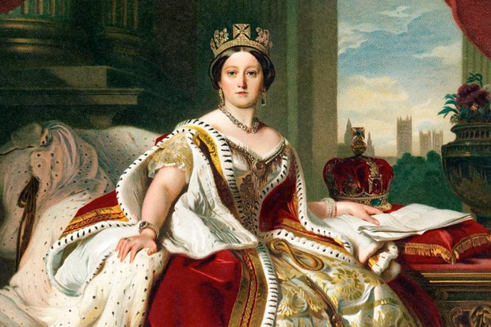
Around 1837, Queen Victoria
Notes:
Around 1837, Queen Victoria taught the world what it meant to be lavished upon.
Not only the giving of flowers, but when you have money and influence like she did, the gifts will come in many more kinds of packages.
She was the start of turning Valentine’s Day into a commercialized frenzy.
Thanks to her influence, prudish Victorians adored showering each other with Valentine’s Day gifts

Slide 8

1847 Richard Cadbury, Heart boxes
1907 Hershey, Kisses
1923 Clara Stover, Bungalow Candies
Notes:
What of the other Valentine’s Day staple?
In the Early 1800s J.S. Fry & Sons took the Aztec cocoa drink and figured out how to produced the first modern bar of chocolate. However, Fry only produced these wares on a small scale.
Enter Richard Cadbury. In 1847, British chocolate maker. Richard Cadbury recognized a great marketing opportunity for the new chocolates and started selling them in beautiful decorated boxes of his own design. These boxes had the added purpose of storing the love letters after the chocolate was gone. So it can be said that Cadbury connected chocolate to Valentine’s Day.
US Harrisburg PA →Of course, innovation would not end there; Hershey laid out chocolate kisses in 1907, and
Colorado→ Clara Stover started wrapping her “Bungalow Candies” in 1923.

Slide 9

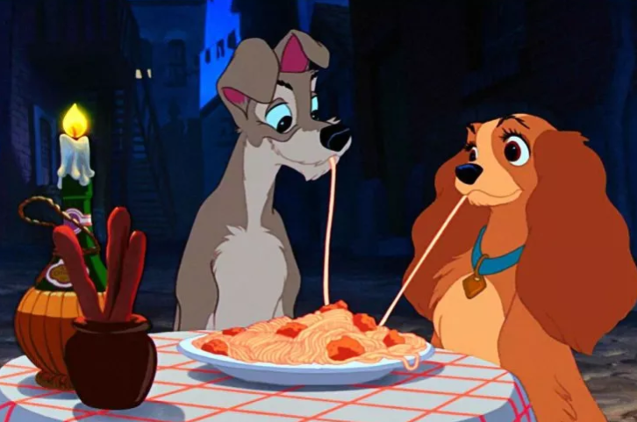
1933 Jean Harlow’s performance of Dinner at Eight
1955 Lady and the Tramp
Notes:
Got the flowers, got the chocolate→ what makes the connection to movies & wine?
Hollywood has also helped perpetuate the Valentine’s Day traditions. There are plenty of noteworthy movie moments that say this is a special day for romance, but here are two of our favorites.
The first happened in 1933 with Jean Harlow’s performance in the film Dinner at Eight. There we find Harlow lounging in bed, seductively nibbling her way through a box of chocolates. What a life!
Second, did you notice in the Disney flick, Lady and the Tramp, kids are taught early in life that in order to have a romantic dinner date with spaghetti between your paws, you must have a fiasco of Chianti to wash it all down? Honestly, there is no shortage of romantic movies from which to choose.
Next to start on our adventure of a romantic date night……….

Slide 10
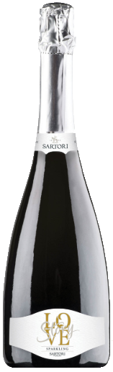
Sartori di Verona, Love Story Sparkling Soave DOC, Italy NV
Chocolove Mini Orange Peel in Dark Chocolate
Sparkle (2012)
Notes:
The love interest meeting….
Sartori di Verona, Love Story Spumante Soave DOC NV
Region: Soave DOC in the Colgnola ai Colli Area, Italy
Grape: Garganega
History:
Banfi is the parent company?
https://www.banfiwines.com/winery/sartori-di-verona/
Established in 1898, celebrated 120 years in 2018 Pietro Sartori bought the 1st vineyard in Negrar
1st Generation Pietro Sartori era: Despite a rather grumpy character, he had certain affections for his great-grandsons. The vineyard was founded out of Pietro’s entrepreneurial spirt
-Spent his days in a 1000 different undertakings. Pietro saw an opportunity to become a restaurateur/ inn keeper in a strategic place where merchants, small industrialist, businessmen all gathered. It was necessary to have a supply of wine that was sufficient in quantity and quality.
-In 1898 Pietro bought the Negrar vineyard to ensure he would always have wine for his clientele. Still the time of horse & buggy. Pietro found opportunities to expand by selling wine in Verona, Brescia, Lake Garda, and lower Trentino.
Had 5 children and encouraged them all to higher education
2nd Generation Regolo, the only son worthy to take on the company & passion for wine. Regolo was regarded as a talented wine broker w/ an extraordinary palate. He had a vision that took off for marketing around the world. 1947 started a number or expansions.
1960-1990s Regolo developed exporting routes for his wines to Germany, Britain, US. Amarone, Valpolicella, and Soave most notable
At the end of the 1990’s Regolo’s sons Franco and Pierumberto took the reigns and again changed the direction of the company. In 2002 Sartori partnered with the Director of the Cantina Social di Colognola (Co log no la). Sartari had the world market contacts, The Cantina had the production facilities and capability of making high quality wines.

Slide 11
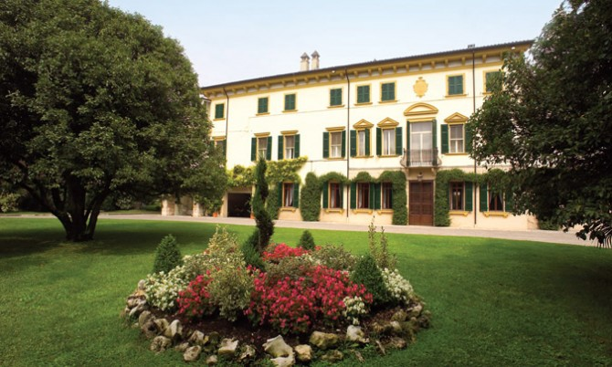
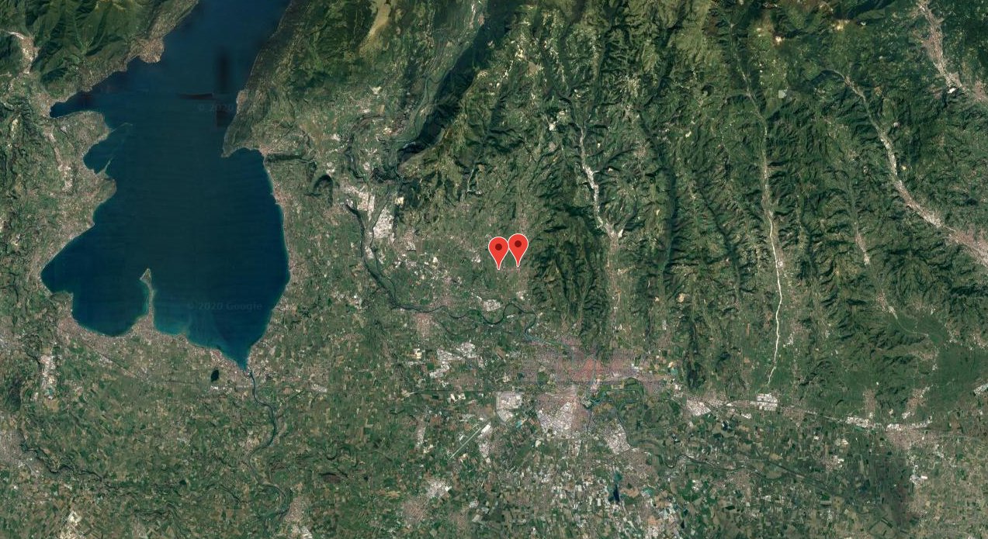
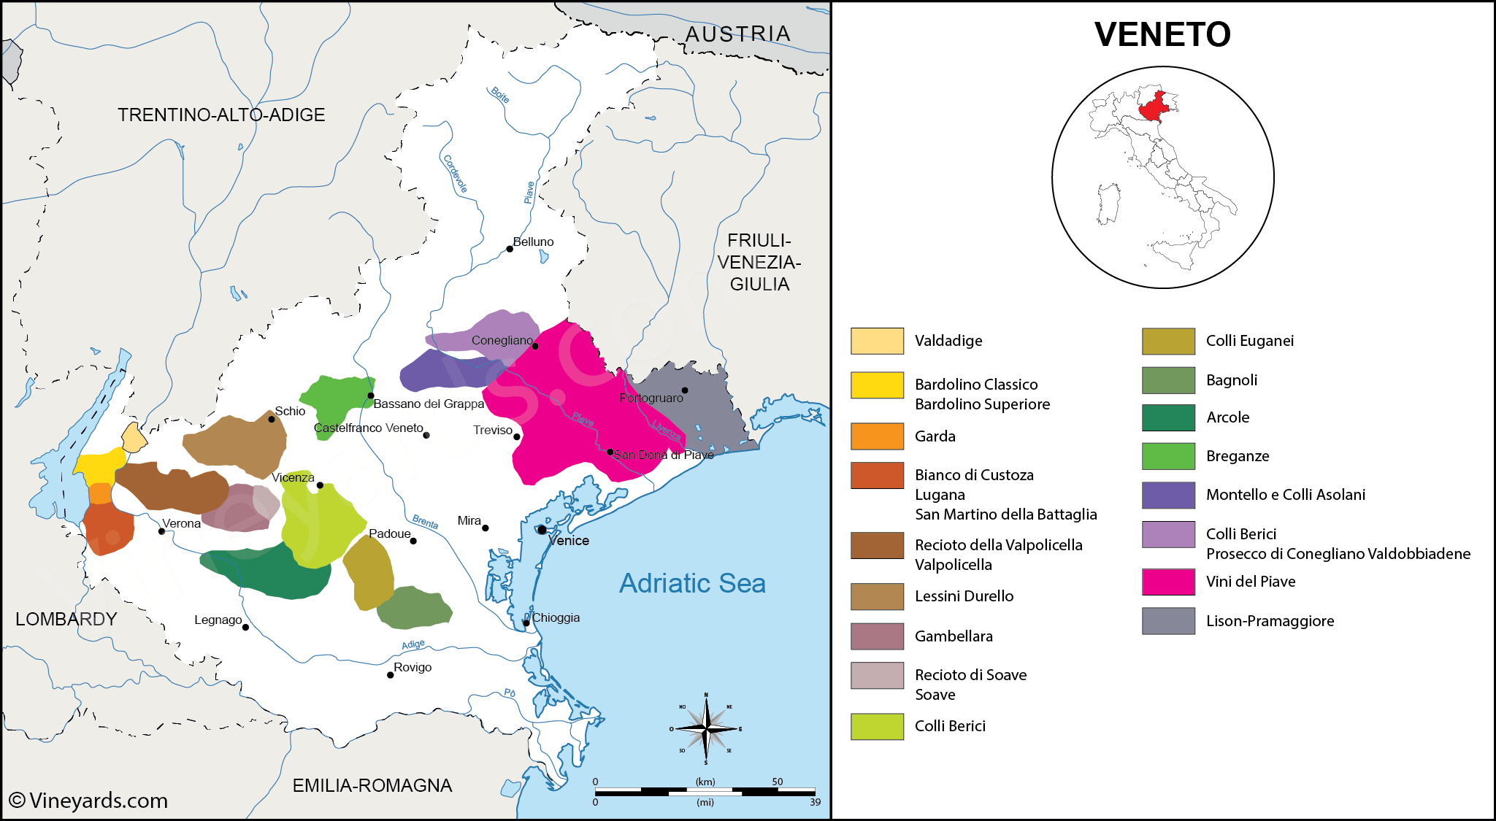
Notes:
Tasting notes: Complex aroma of ripe apples, bread crust and a touch of vanilla
Specs:
Vineyard
Calcareous alluvial
Winemaking
1st fermentation of which 30% is in wood.
Cuvee is prepared for 2nd fermentation which takes place over 3 months at controlled temp of 60F – short bottle age, then enjoy
ABV 11%, Acidity 5.5g/L, RS 10.5 g/L
Awards: Silver Medal in Winemaker’s Challenge 3 Feb 2020
Pairing: Perfect as an aperitif and as accompaniment to light dishes, especially fish
Price: $ 18.99

Slide 12
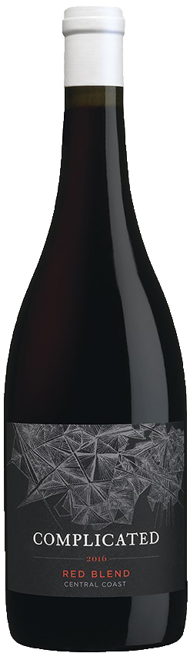
Taken Wine Co., Complicated Red Blend Central Coast, California 2015
Chocolove Strawberry Dark Chocolate
Seems Like Old Times (1980)
Notes:
Complicated – figuring out the quirks that make you fall in love, that are just adorable to you.
Taken Wine Co., Complicated Red Blend Central Coast 2016
Region: Central Coast, California
Grape: 51% Grenache, 35% Syrah, 12% Carignan, 2% Merlot
History:
Trinchero Family Estates (established in 1948) -press release 13 August 2013 added The Taken Wine Company brand to its portfolio
Carlo Trinchero and Josh Phelps both grew up in the business.
Carlo Trinchero is a third-generation member of the Trinchero Family, Napa Valley vintners since 1948
It was Trinchero Family Wines in the early 1970s than changed the way Americans drink wine when they created Sutter Home White Zinfandel.
Josh Phelps also has roots in the business, the son of well-regarded wine maker Chris Phelps, who spent his career in the wine industry creating award-winning wines in Napa and Bordeaux.
Childhood comrades Trinchero and Phelps created Taken Wine Company with the philosophy “to craft great wines to share with friends”. The name was chosen when they were having difficulty finding a moniker for their wines that was not already “Taken”. 1st release was in 2010 and brand expanded after to Complicated and Available which became a social media create relationship status

Slide 13

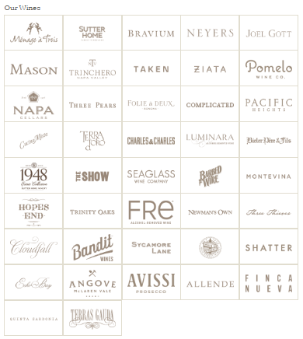
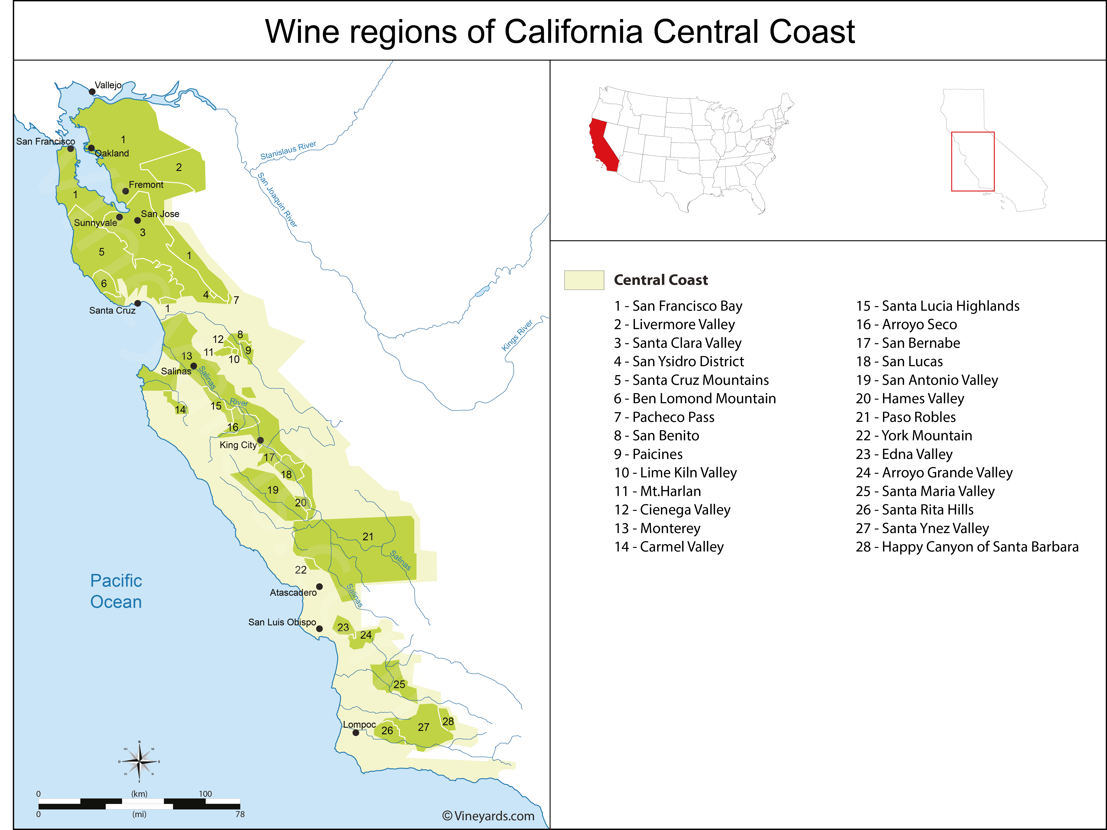
Notes:
Tasting notes: Inviting aromas of ripe red fruit are complemented by fresh flavors of cherries and strawberries, accented with sweet, spicy oak tones. The wine is opulent yet balanced with a soft palate and a smooth, rounded, supple finish.
Specs:
Vineyard- Sourced from vineyards throughout the coveted Central Coast and a small part of Contra Costa County, this wine is inspired by the Rhône and Priorat regions, yet with California soul. The Central Coast is a large AVA spanning from San Francisco County south to Santa Barbara County.
The 2016 vintage experienced an earlier budbreak than normal. Sourced mainly from the mid to northern part of the Central Coast, the moderate temperatures elongated the growing season allowing the grapes to retain acidity and develop intriguing, diverse characteristics
Winery -Aged in French and American oak barrel
Pairing: grilled, stewed and braised meats like beef, veal, pork, chicken and of course game. Grenache holds up well to hearty dishes like cassoulet and it’s a good match for less spicy styles of Asian cooking.
Price: $ 23.99

Slide 14
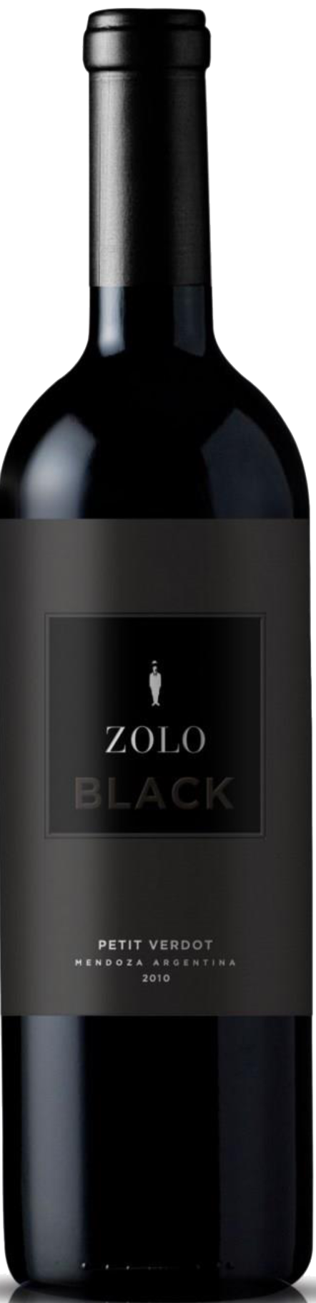
Zolo, Petit Verdot Black Mendoza, Argentina 2012
Chocolove Cherry and Chilies Dark Chocolate
Romancing the Stone (1984)
Notes:
Col Zolo- the bad guy in Romancing the Stone → because every good love story has to develop some struggle that the hero has to over come.
Zolo, Petit Verdot Black Mendoza 2012
Region: El Jarillal Vineyard in Alto Agrelo, Mendoza
Ugarteche, Lujan de Cuyo (Alto Agrelo) vineyard is at 3,440f/ 1050 M has a relatively steep slope, which is important to avoid frost in this cool area. The Terroir produces intense fruity wines, yet elegance, which comes from slow, correct ripening.
242 hectares, on the way to the Uco Valley where the soil & microclimate generate a perfect combination for Bonarda and Syrah
Grape: 100% Petit Verdot
History:
Bodega Tapiz, Zolo and Wapisa Wineries are under the leadership of President & Owner Patricia Ortiz
Zolo established in 2003 by Patricia Ortiz regarded as one of Argentina’s most forward-thinking women wineries. Her vision of creating wines with elegance and identity reflective of the terrier and respectful of the environment – sustainably farmed
Man on the Zolo label represent Patricia’s husband, who was left solo in Buenos Aires.
Patricia avid art collector and former nephrologist, needing to combine both her art and scientific skills and turned toward winemaking.
Gathered around her wine professionals, wine maker Fabian Valenzuela and vineyard manager Carlos Correas, and consultant Petrus.
Zolo and Tapiz are critically acclaimed Argentine brands in the US.
Her team became pioneers with Wapisa, a winery in Patagonia.
Open to tourism visit with its traditional carriage ride through the vineyard, and the Llama tasting and gift shop
Club Tapiz → top lodging and spa destination built in 1890. Declared historical architectural and Tourist Heritage of the region.
Patricia lived in the US and speaks English. She became Mendoz’s top ambassador. In 2019 she became the first female President of Bodegas de Argentina.

Slide 15
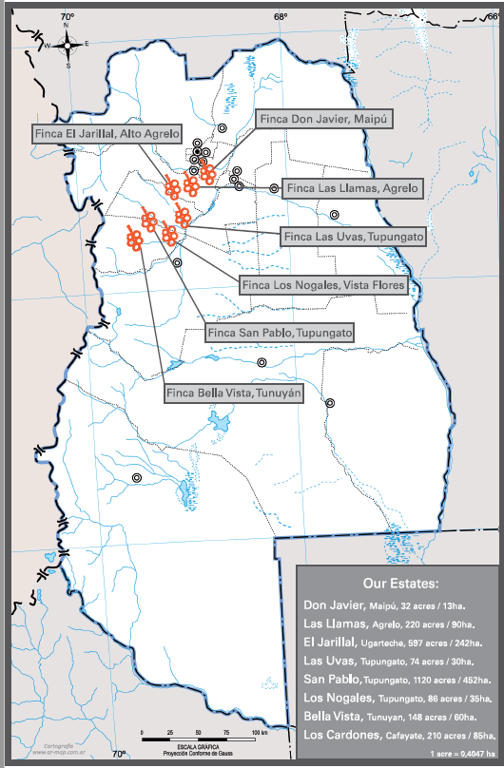
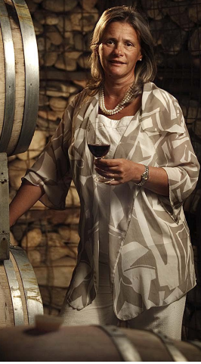
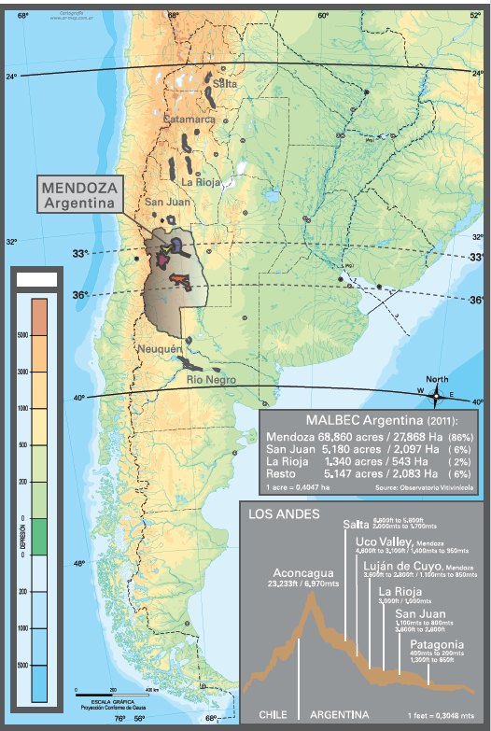
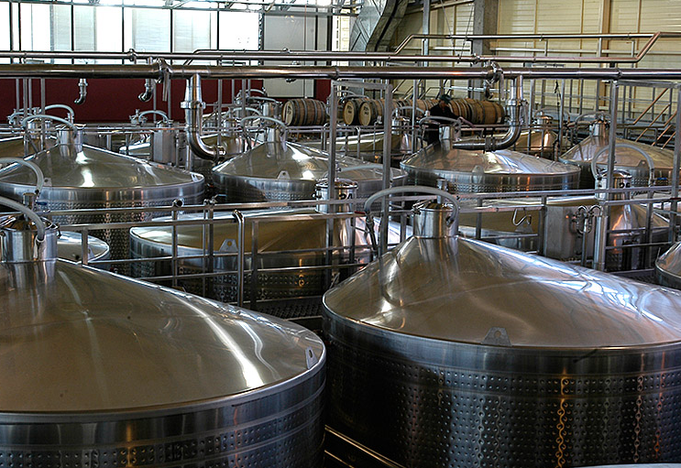
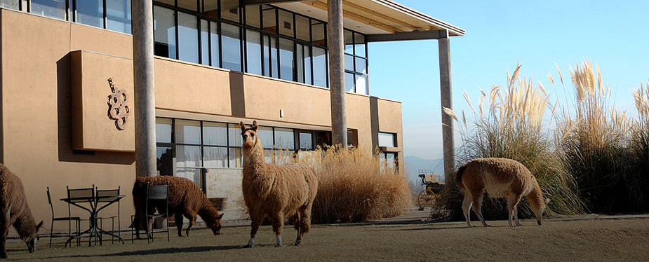
Notes:
Tasting notes: Intense deep red color with violet hues. The nose is intense, with aromas of black fruits as blackberry, black currant and blueberry accompanied by spicy notes like clove. Delicate vanilla scent. Good structure and mouthfeel, with a lingering and elegant finish.
Specs:
Vineyard
Vineyards in Alto Agrelo at 1050 Ml (3444 ft)
Winery
Cold pre-maceration at 8C for 5 days. Fermented in stainless steel tanks for 15 days at 28C then rest on lees for 16 day
100% malolactic fermentation
18mts in French oak only 700 cases produced
14.2% ABV, 6.55g/L total acidity, 3.52 pH, 2.34 g/L RS
93 points Wine & Spirt
Pairing:
Price: $ 41.99
http://www.vinodelsol.com/pos/zolo/PatriciaOrtizBio.pdf

Slide 16
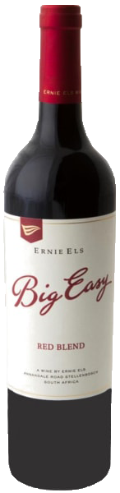
Ernie Els, Big Easy Red Stellenbosch, South Africa 2017
Hershey Bar
The Big Easy (1986)
Notes:
Our hero has to struggle a bit to really define what the problem actually is. Then, “Wal-la!” an apophony!
Ernie Els, Big Easy Red
Region: Stellenbosch, South Africa
Winery located on the slopes of the Helderberg Mountain w/in Stellenbosch appellation infamous “golden Triangle”
North facing slopes, rows flowing east-west (optimal utilization of sun & warmth)
Cape’s Mediterranean climate 650mm rainfall. Proximity to Atlantic results in cooling sea breezes that keep temps low, extends the ripening period.
Golden Triangle – The Helderberg wine growing area stretches from the Somerset West to the edge of Stellenbosch
Elevation ranges from 60-400 m. Granite, shale, sandstone clay soil. Different levels of water holding capacity/ drainage make it possible for dry-land farming or micro irrigation
Near False Bay – vines benefit from cooling ocean breezes, producing small berries w/ optimum ripeness, concentrated flavors, smooth tannins
Grape: 60% Shiraz, 20% Cab Sauv, 5% Grenache, 5% Mourvedre, 5% Cinsault, 5% Viognier
History:
https://issuu.com/teetimesgolfmagazine/docs/teetimesfeb18
Erine Elis born in 1969 Johnannesburg South Africa, was a outstanding athlete -soccer, rugby, cricket, tennis as a youngster. Won Junior Championship in Sand Diego CA.
1989 Elis won the South African Amateur Strokeplay which turned him professional gulf. The following years had international gulf winnings the Dunlop Phoenix in Japan, US Open (1992) -which earned him PGA Rookie of the Year. He returned to South Africa where he won twice more.
→Established in 1999 Els’s passion for excellence turned toward winemaking Louis Strydon -head winemaker since the beginning. Achievements included being rated the internationally respected Wine Spectators Top 100 Wines 4 consecutive years, handful of South African winemaker awards and most recently appointed Chairperson of the Cape Winemaker’s Guild
→ 6 foot 3 inch physique and his fluid swing earned him the nick name “The Big Easy”.
→In 2005 Elis had a sailing accident that took him out of playing golf for a time. But refocused on other pursuits; his son has autism. Elis became active in charities devoted to that condition. The Els for Autism Pro Am raises money and support the Renaissance Learning Centre, a charter school for autistic children.

Slide 17
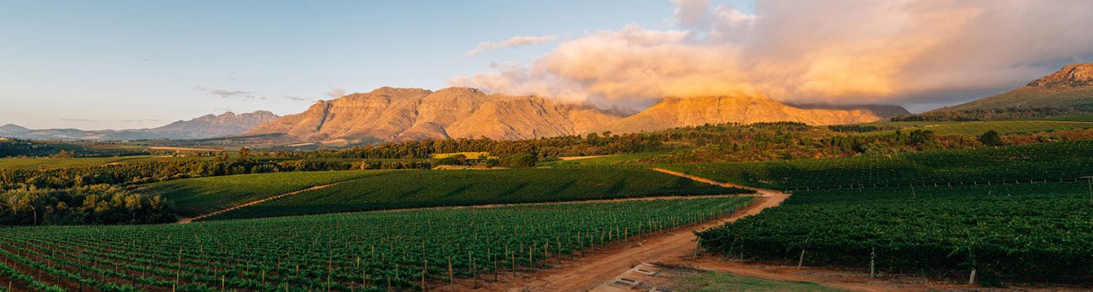
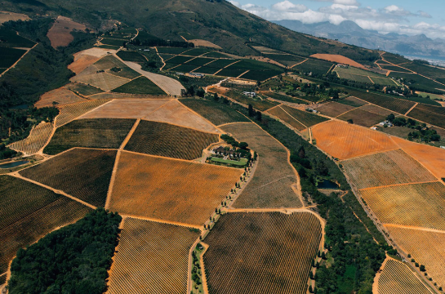
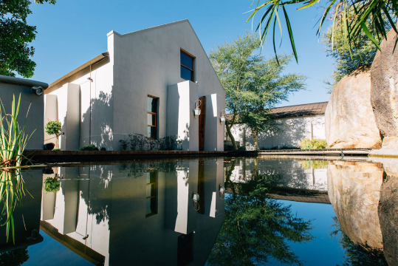
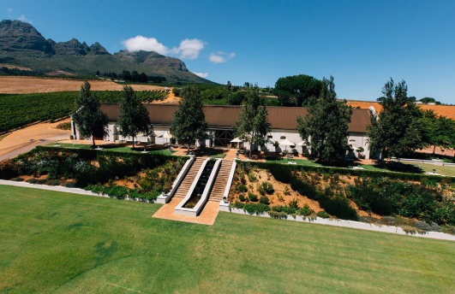
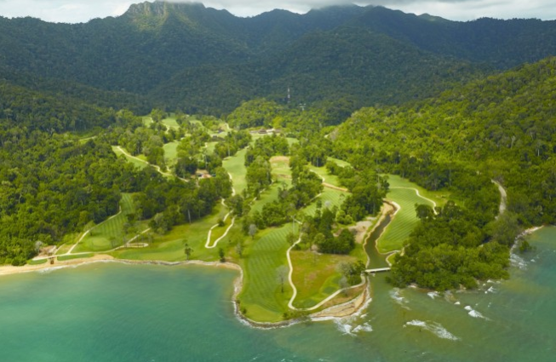
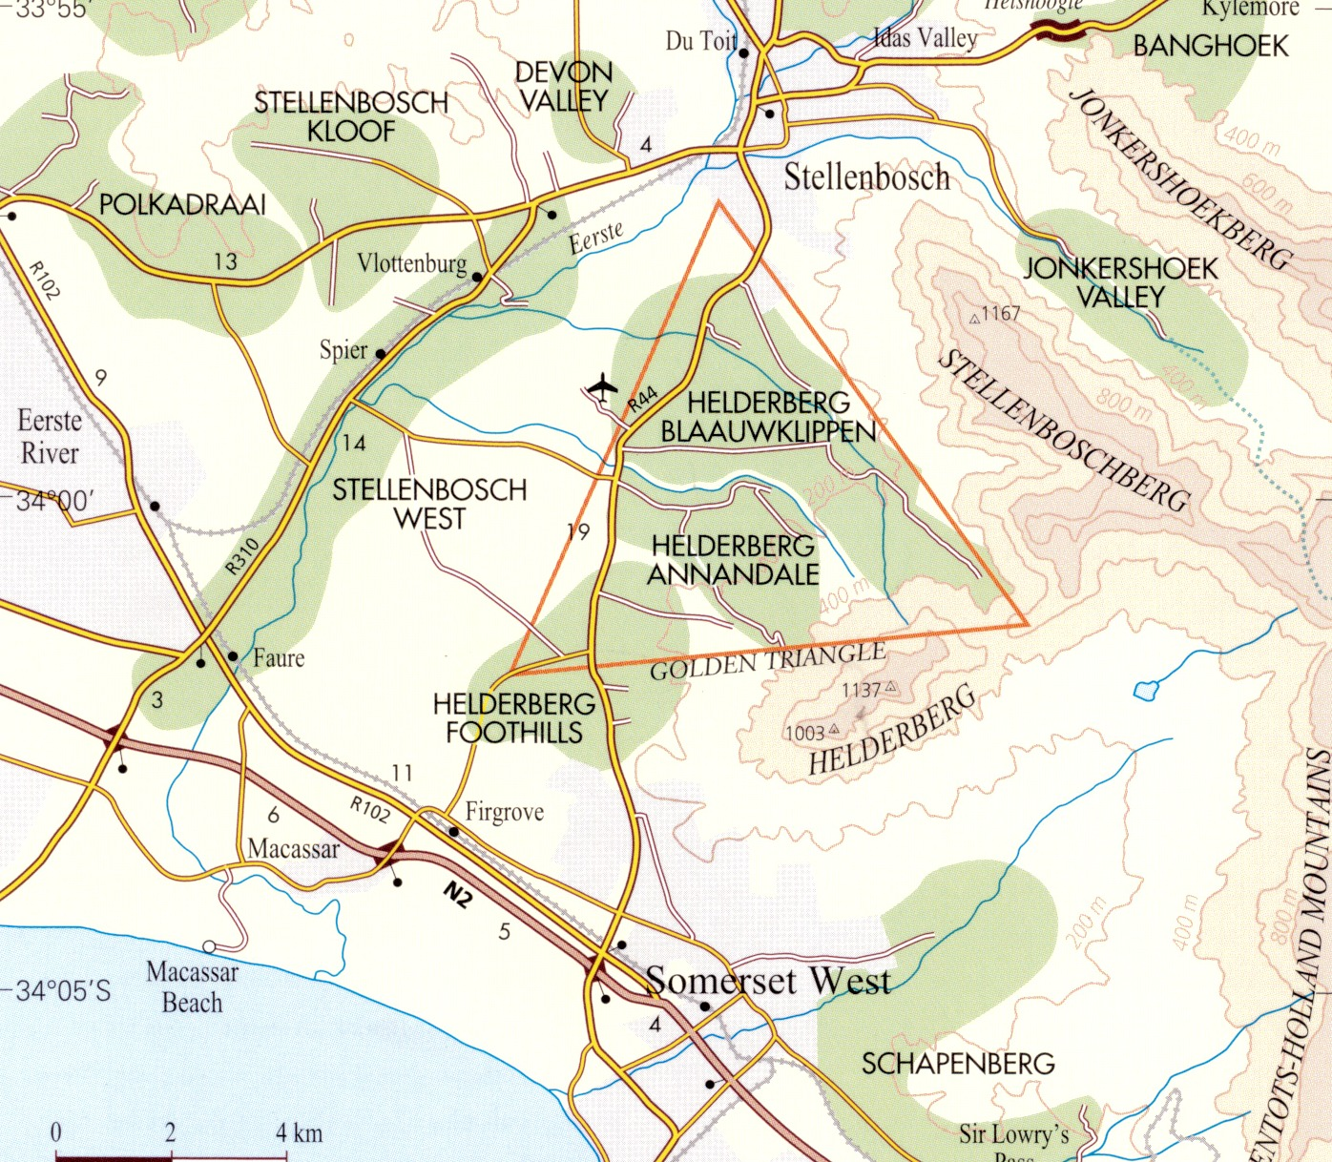
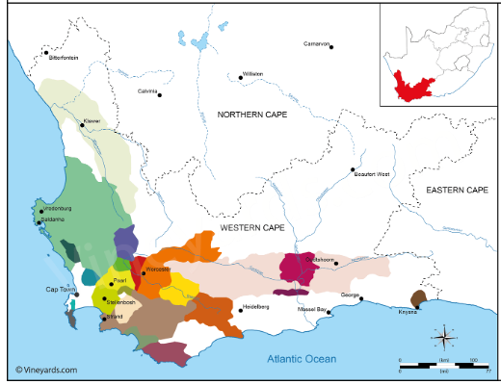
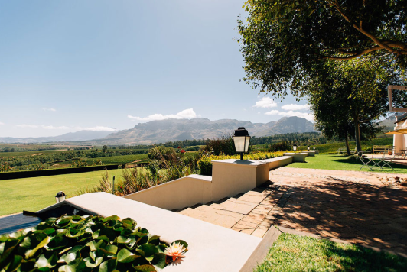
Notes:
Since its formation in 2000, the company has received global recognition with a string of prestigious accolades. In 2015 Ernie was voted ‘Designer of the Year’ at the World Golf Awards. In addition, many of Ernie’s signature courses have won prestigious industry awards including ‘Best New Golf Course in the World’ for The Els Club Teluk Datai (pictured below) in 2014. In 2016, it also became the first layout in the Ernie Els Design portfolio to be listed in Golf Digest magazine’s prestigious ‘World Top-100’.
Tasting notes: this dry vintage was conducive to producing a concentrated, beguiling wine that dazzles the scenes. Brooding nose that takes time to unfold. Complexity with ripe blackberry, liquor ice, fine chinses spice, and smoked herbs. Fruit-laden tannins, covered in melted milk chocolate and morello cherries. Backbone of minerality and definition. Shows grip, power, youth, suggesting up to a decade of maturation.
Specs:
Vineyard
Soil contains scullyformation w/ oak leaf and clay components surface. Deeper granite
GSM, Cab, and Vio sourced from selected vineyards on the Helderberg Mt w/in Stellenbosch appellation. Soil high gravel content, offers rich middle palate, giving wine depth & fruity purity
2016/1017 growing season -drought; starting w/ a more than normal dry winter, just enough moisture in sping to have good bud burst, developed smaller berries, lead to concentrated flavors. Warmth continued until harvest. Astounding good vintage 2017, w/ great structure
Cinsault sources from 26-year-old bush vines in the Perdeberg region
Winemaking
Pairing: dishes featuring Mediterranean spices (red pepper, sage, rosemary, olives)
Price: $ 22.99

Slide 18
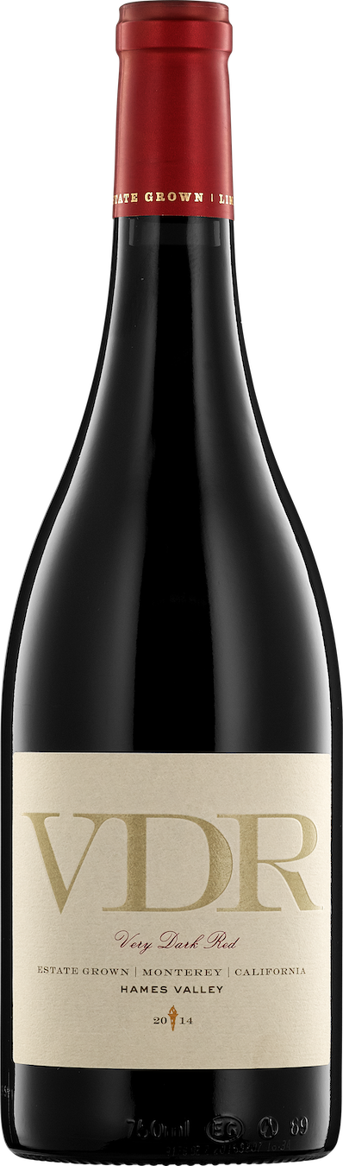
VDR, Very Dark Red Estate Grown Hames Valley, California 2015
Chocolove Mini Raspberries in Dark Chocolate
Love Story (1970)
Notes:
Here we watch our hero execute the “Plan” to get rid of the bad guy, some how make it up to the girl and win her back
He must travel through the Very Dark Red path and the whole world is biting their nail to see if he is going to be successful!
Scheid Family Wines, VDR, Very Dark Red Estate Grown Hames Valley 2015
Region: Hames Valley, Hames Valley Vineyard → sub appellation of Central Coast, CA
Winery is just north of the San Luis Obispo county line & lies at the food of the Santa Lucia Range in a Region IV (southern reach of Monterey County)
Cool Maritime climate but Hames Valley is shelter from the chilly winds down the Salinas Valley corridor. It receives a healthy dose of sunshine during the day. Thus, slightly warmer than other regions of Monterey. Followed by precipitous drops in temp as sun goes down. Diurnal range swing of 50F
Elevation range 472f-1289f
Grape: 60% Petit Verdot, 40% Petite Sirah
Petit Verdot is a grape of dark color, stout tannins, and concentrated flavors. The small berries of Petite Sirah create a more intense maceration with a high skin-to-juice ratio and some of the longest tannins of any vinifera. Together they create a dark, concentrated wine that can be enjoyed now but will age well for a decade or more.
History:
VDR is under the ownership of Scheid Vineyards
Winemaker Dave Nagengast
Scheid Family Wines saw an untapped potential in Moneterey County in 1972 infancy of wine in CA. Started out growing grapes that were sold to other wineries which turned into 5 unique distinctive labels: Scheid Vineyard, District 7, Metz Road, VDR, and Stokes’ Ghost.
12 estate vineyards. 4000 acres located along 70 mile spread of the Salinas Valley,

Slide 19
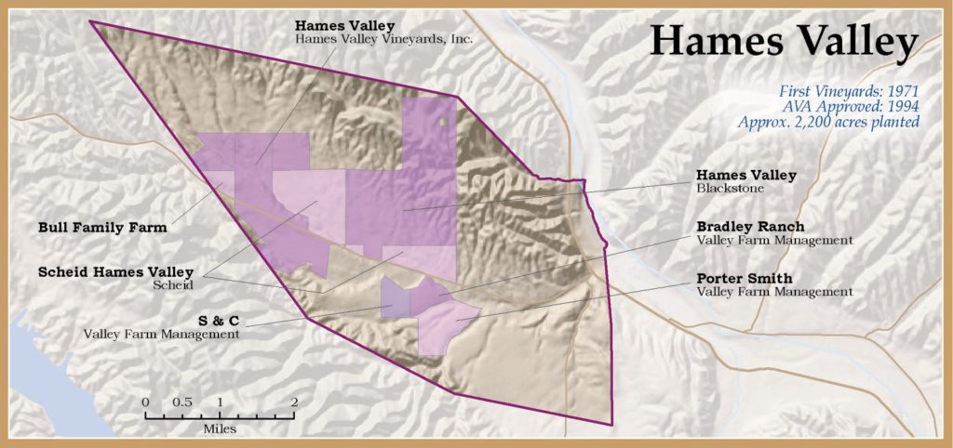
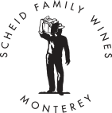
Notes:
Tasting notes: Very Dark Red. The name frankly speaks for itself. Petit Verdot is a grape of dark color, stout tannins and concentrated flavors. The small berries of Petite Sirah means a more intense maceration of skin-to-juice ratio and some of the longest tannins of any vinifera. Together they create a dark, concentrated wine that can be enjoyed now but will age well for a decade or more. VDR is full-bodied yet supple, with deep, ripe fruit flavors of black currant and black raspberry perfumed by delicate notes of crushed violet. A firm, chalky tannin structure belies the velvety, luscious mouthfeel. Dense flavors integrate beautifully for a long, layered finish.
Specs:
Vineyard – lockwood shaly loan with fragments of broken rock that create fracture lines for the vines roots to penetrate deeply
Due to the warm days, grape growers in the region have a fine attention to vineyard row direction, trellis design, and canopy management in order to alleviate direction exposure of fruit to sunlight.
Winery – night harvest, destemmed, crushed, fermented at 80F. Daily pump overs to extract optimal flavors, color, dryness.
Must pressed, settled, racked clean for aging on AM and Hungarian oak. Goal to retain varietal character; each lot was fermented and aged separately
Sustainable → certified b California Sustainable Winegrowing Alliance- 3rd party organization that sets forth best practices in environmental stewardship, conservation of natural resources, and socially equitable business practices (annual inspections)
Pairing: Grilled meats, short ribs, wild game, rich stews, savory Italian dishes, rib-eye and smoked cheeses
Price: $ 25.99

Slide 20
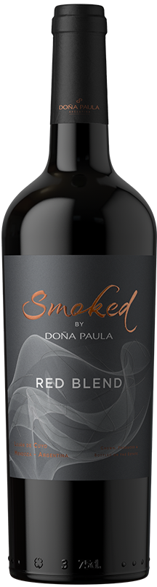
Doña Paula, Smoked Red Blend Luján de Cuyo, Argentina 2017
Chocolate Truffle
Summer of ‘42 (1971)
Notes:
Like every good romantic movie, all things have resolved. And what is the classic thing that you do after great sex? Smoked
Doña Paula, Smoked Red Blend Luján de Cuyo (Luhan da Cooho)
Region: El Alto Vineyard, Lejan de Cuyo → Mendoza
Finca El Alto, this estate name comes form its location in the upper southern part of Lujan de Cuyo, at 1,000 meters of height and it is characterized by presenting warm days and cool nights, and soils that range from sandy loam to clay loan with a variable rock content. In Fince al Alto we focus in the production of red grapes characterized by having sweet and rounded tannins and a great aromatic expression. Our oldest vineyards were planted in the year 1969
Climate mild, with warm days and cool nights
Grape: 60% Cab Sauv, 30% Malbec, 10% Bonarda
History:
Established in 1997 as an Estate winery. 703 hectares of vineyards located in Mendoza
Study of terroir & its many factors around the vineyard
Dug 700 pits. Which concluded to 200 micro-climates
goal is to make wine reflective of the soil, and other characteristics like temperatures
Winkler, who classified climate into 5 categories. Cool, intermediate, warm-intermediate, warm and hot. The climate is a determining factor of the aromatic profile
Cooler climates, for Malbec, the mineral aromas are highlighted, together with black fruits and floral aromas.
While in warmer climates, a greater volume of red fruits and spiced notes is found.
Soil has an affect on concentration off the wine
Combinations; higher stone content, less deep or have layer of calcium
Soil affects can also produce aromas but to a lower extent

Slide 21
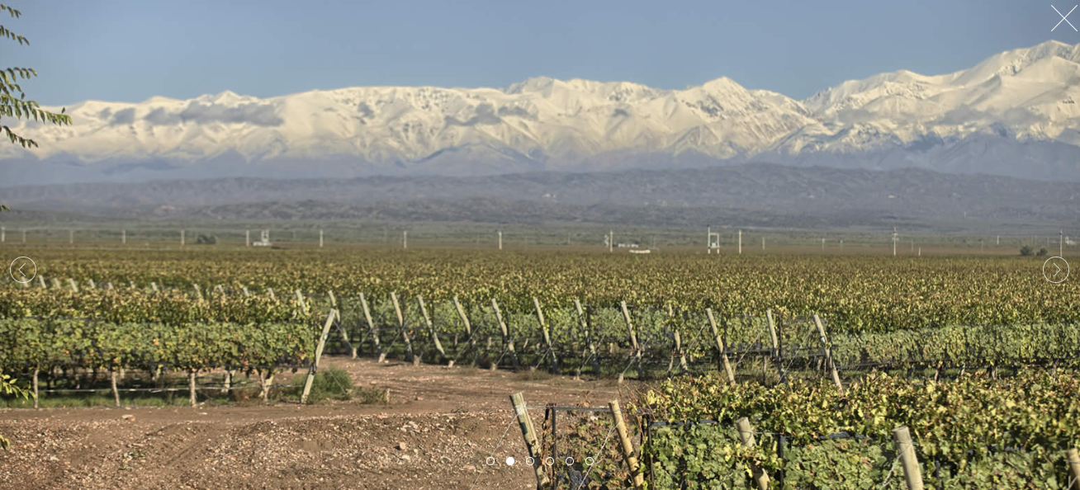
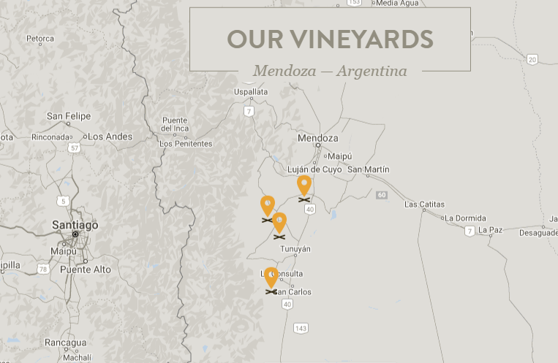
Notes:
Tasting notes: intense violet colored wine, with very complex aromas of red fruit jam, spices, vanilla, and delicate smokiness. On the palate it stans out for its sweet, velvety tannins.
Specs:
Vineyard
7-10 to- drip irrigation and trellis
1050 M (3445 feet) above seal level -warm days & cool nights / average rainfall 10 inches
Sustainable agricultural practices
Winemaking
Harvest between March and the beginning of April.
Crushing, cold soak pre-fermentation maceration – preserve primary aromas
Fermentation at low temp, spontaneous malolactic fermentation
Aged in new, and neutral oak for 12 months
Barrels are smoked with unique process that give them similar aromas found in a traditional Argentinean barbecue (asado)
ABV 13.5%, RS 7 g/L, Acid 5.43g/L Ph: 3.75
Pairing: bbq dry rubs and blue cheese, empanadas, polenta
Price: $ 18.99

Slide 22
50 Best Romantic Movies to Watch on Date Night
Notes:
NewsWeek Ranked: the 50 Best romantic movies to watch on date night 2/8/19
Should be entertaining for both
Should be heartwarming at least to stoke the romantic flames
Should be uplifting (not schindler’s list) crucial to lock in your movie vibe

Slide 23

810 Caroline St, Suite 101 |Fredericksburg, VA 22401 Rita@city-vino.com 540.368.0400

